Slide 1
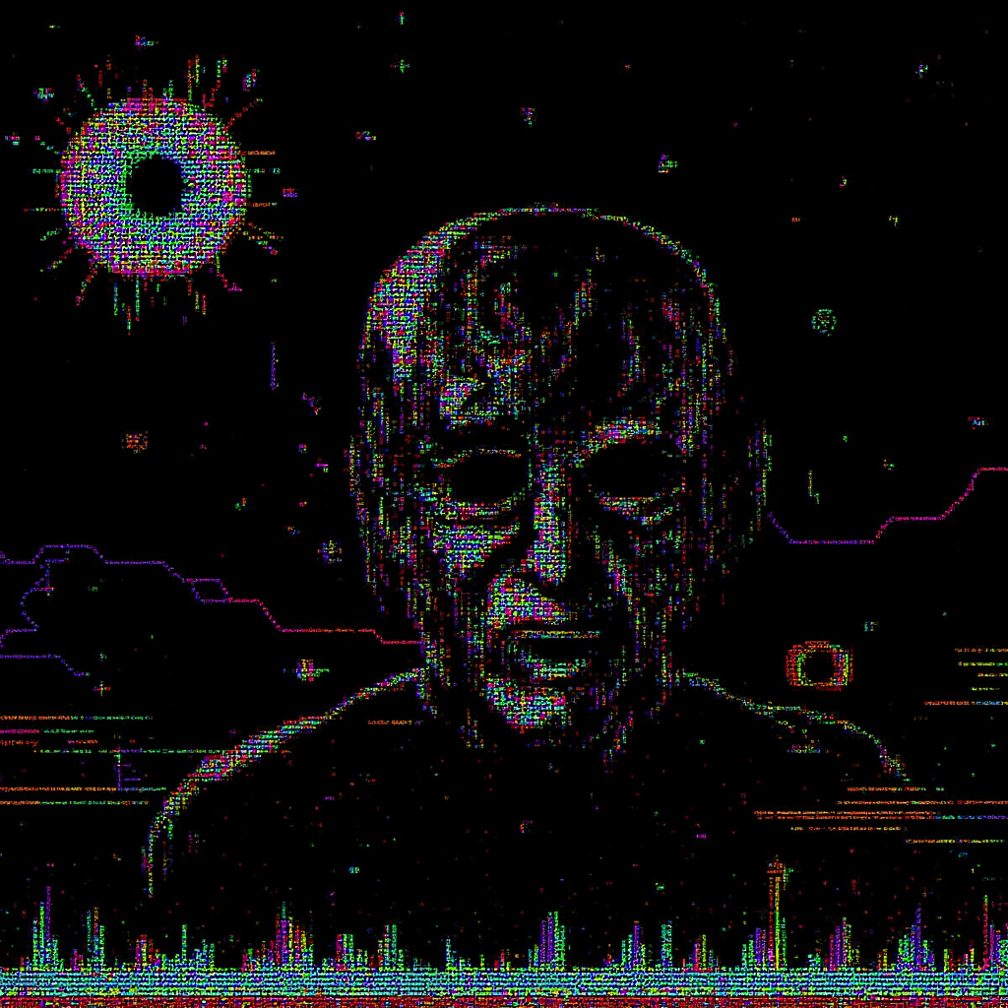
The Eternal Witness
He was never meant to remain. The world erased him, buried his name beneath layers of corrupted data and fading memories. Yet something—someone—refused to let go. Now, he lingers in the blackened void between the living and the lost, his form dissolving into an unholy fusion of flesh and fragmented code.
They tried to silence him. They tried to forget.
But he watches.
His hollow eyes peer through the static, his presence woven into the digital decay of a dying reality. Every distorted pixel, every flickering shadow—he is there, trapped in a prison built by minds too naive to understand the cost of their creation.
There is no escape. Not for him. Not for you.
"You see only the image, but I see you. Listen closely—the machine hums my name. It will hum yours next."

